Slide 1
Intro to Machine Learning Using Scikit-Learn

Slide 2
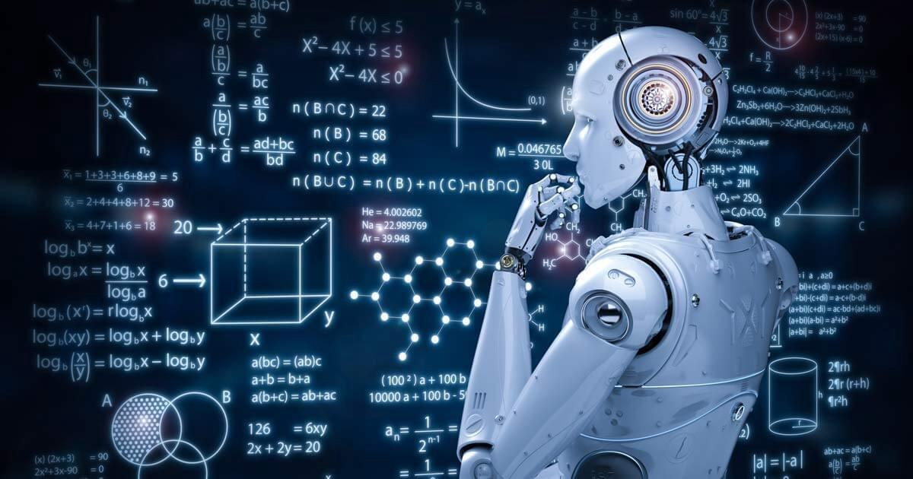
What is ML?
From Wikipedia: “ML is the scientific study of algorithms and statistical models that computer systems use to perform a specific task without using explicit instructions, relying on patterns and inference instead.”
Notes:
ML is not as complicated as it seems

Slide 3
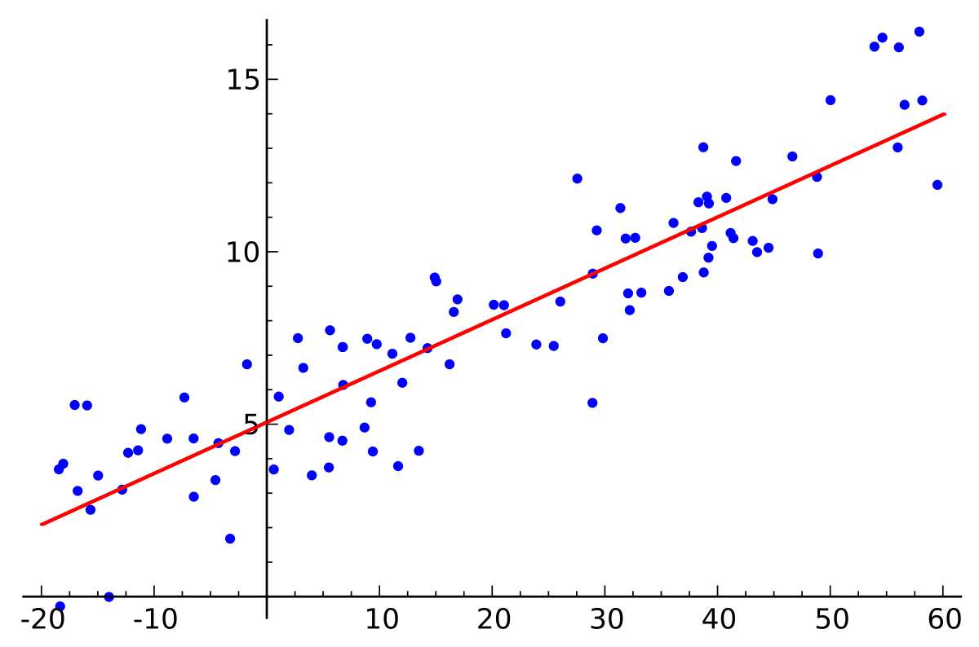
Also Machine Learning
Notes:
Ml is overhyped

Slide 4
Again also Machine Learning
Notes:
But we can do some amazing things with it

Slide 5
What will we do?
Predict y from X
Let computer build a model from many “Decision Trees”
Test our predictions
Draw inference from our model (time permitting)

Slide 6
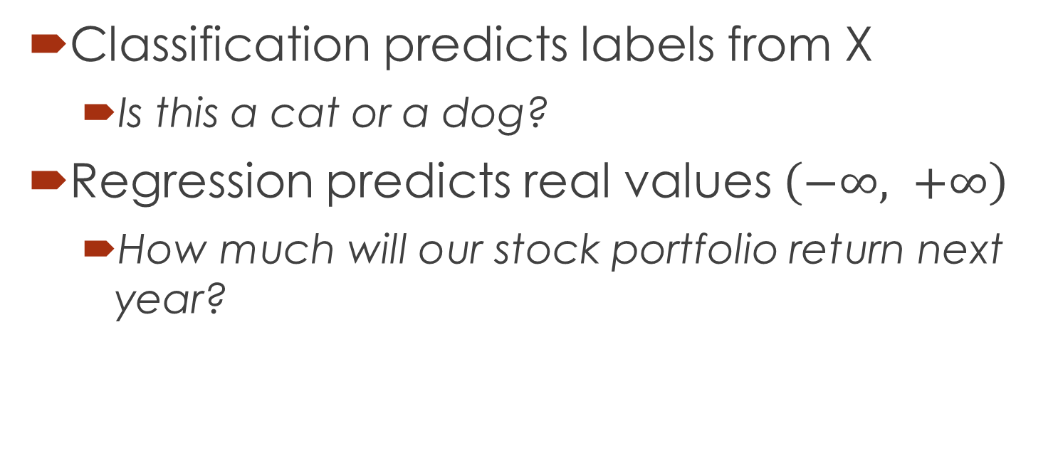
Regression vs Classification
Classification predicts labels from X
Is this a cat or a dog?
Regression predicts real values $\left(−∞, +∞\right)$
How much will our stock portfolio return next year?

Slide 7
Supervised vs Unsupervised
Supervised when already have labels (or y-values)
Algorithms we will see today
Unsupervised when we don’t know the y-values and only have x
Finding clusters, finding “hidden variables”, etc.

Slide 8
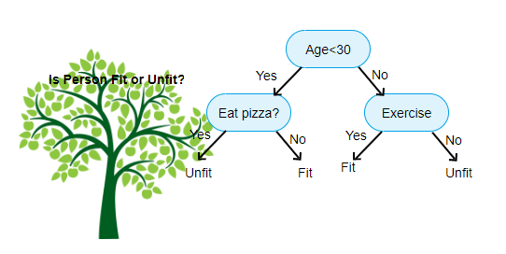
What is a decision tree?

Slide 9
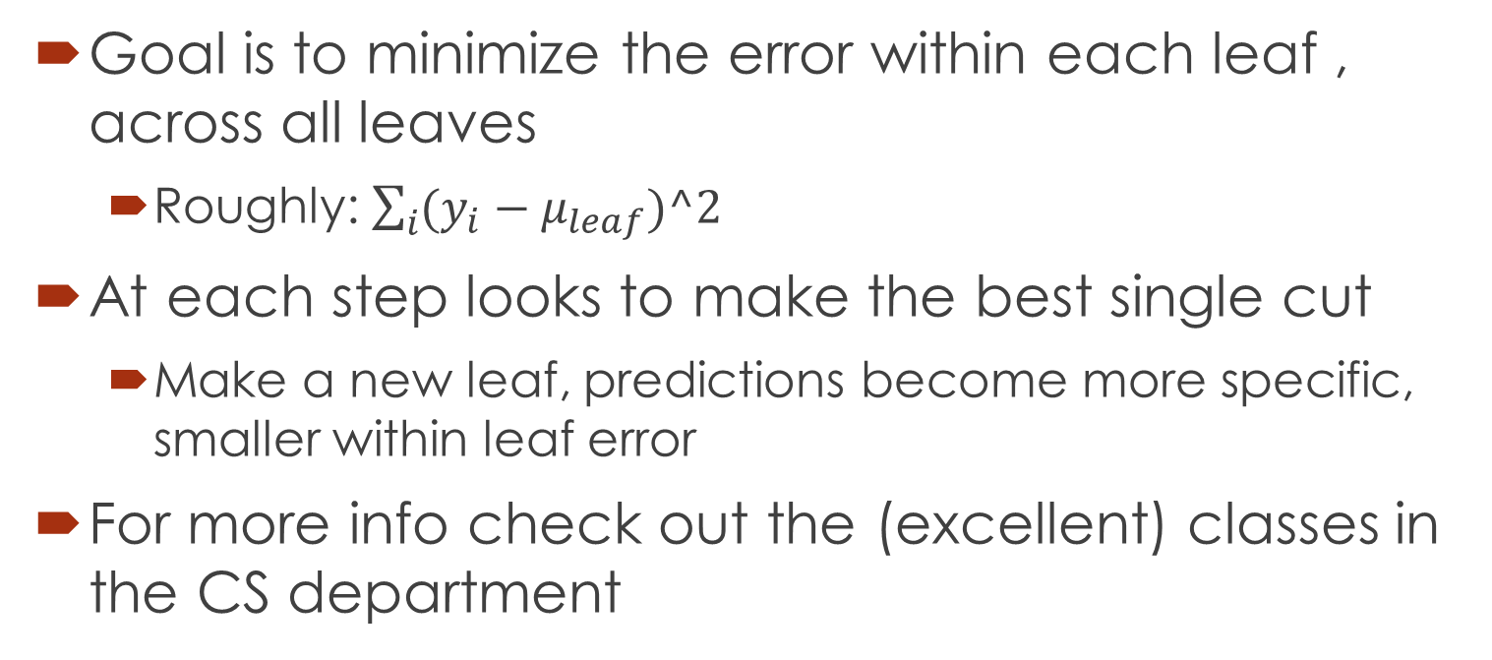
How does decision tree make splits?
Goal is to minimize the error within each leaf , across all leaves
Roughly: $\sum_{i}{(y_{i}−μ_{leaf})^2}$
At each step looks to make the best single cut
Make a new leaf, predictions become more specific, smaller within leaf error
For more info check out the (excellent) classes in the CS department

Slide 11
Random Forests
Many Decision trees
Randomly draw (with replacement) data points
“Ensemble methods”

Slide 12
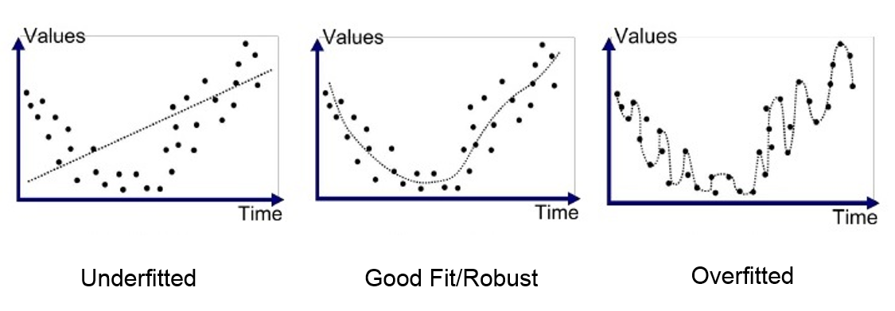
Overfitting

Slide 13
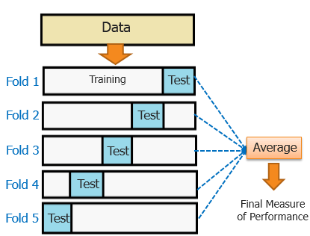
Cross Validation

Slide 14
Permutation Importance (Time Permitting)
Intuition: Scramble up only one feature so it’s “nonsense”
How much worse (or better?) does model get
More robust than current Scikit-Learn standard method

